Slide 1
Chapter 12: Mass-Storage Systems

Slide 2
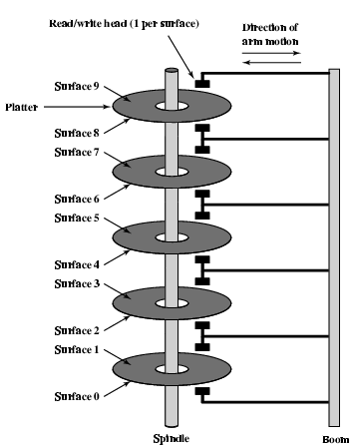
Disk Logical and Physical Structures
Disk drives are addressed as large one-dimensional arrays of logical blocks, where the logical block is the smallest unit of transfer.
The one-dimensional array of logical blocks is mapped into the sectors of the disk sequentially.
  Sector 0 is the first sector of the first track on the outermost cylinder.
  Mapping proceeds in order through that track, then the rest of the tracks in that cylinder, and then through the rest of the cylinders from outermost to innermost.

Slide 3
Disk Scheduling
The operating system is responsible for using hardware efficiently — for the disk drives, this means having a fast access time.
Access time has two major components
  Seek time is the time for the disk are to move the heads to the cylinder containing the desired sector.
  Rotational latency is the additional time waiting for the disk to rotate the desired sector to the disk head.
Minimize seek time
Seek time ≈ seek distance

Slide 4
Disk Scheduling (Cont.)
Disk scheduling choose which one of the pending requests in the queue for disk to service next
Several algorithms exist to schedule the servicing of disk I/O requests.
  FCFS scheduling
  SSTF scheduling
  SCAN scheduling
  C-SCAN scheduling
We illustrate them with a request queue (0-199).
98, 183, 37, 122, 14, 124, 65, 67
Head pointer 53

Slide 5

FCFS
Illustration shows total head movement of 640 cylinders.

Slide 6
SSTF (Shortest-seek-time first)
Selects the request with the minimum seek time from the current head position.
SSTF scheduling is a form of SJF scheduling; may cause starvation of some requests.
Illustration shows total head movement of 236 cylinders.
98, 183, 37, 122, 14, 124, 65, 67
Head pointer 53

Slide 7

SSTF (Cont.)

Slide 8
SCAN
The disk arm starts at one end of the disk, and moves toward the other end, servicing requests until it gets to the other end of the disk, where the head movement is reversed and servicing continues.
Sometimes called the elevator algorithm.
Illustration shows total head movement of 236 cylinders.

Slide 9

SCAN (Cont.)

Slide 10
C-SCAN
Provides a more uniform wait time than SCAN.
The head moves from one end of the disk to the other. servicing requests as it goes. When it reaches the other end, however, it immediately returns to the beginning of the disk, without servicing any requests on the return trip.
Treats the cylinders as a circular list that wraps around from the last cylinder to the first one.
Illustration shows total head movement of 382 cylinders.

Slide 11

C-SCAN (Cont.)

Slide 12
Selecting a Disk-Scheduling Algorithm
SSTF is common and has a natural appeal
SCAN and C-SCAN perform better for systems that place a heavy load on the disk.
Performance depends on the number and types of requests.
Requests for disk service can be influenced by the file-allocation method.
  Continuously allocated file will generate several request that are close together on the disk, resulting in limited head movement
  Linked or indexed file may include blocks that are widely scatted on the disk, resulting in greater head movement
The disk-scheduling algorithm should be written as a separate module of the operating system, allowing it to be replaced with a different algorithm if necessary.

Slide 13
End of Chapter 12

